Slide 1
IMPERIAL
B
BUSINESS SCHOOL
US Treasury PCA Relative-Value
Strategy
A systematic macro strategy: research, results & honest critique
AQMS 2026 · Group 13
]
2 June 2026
Notes:
State the hypothesis in one breath: the US curve is ~3 factors, and we trade the small orthogonal residual that mean-reverts. This deck is an honest research ladder — each refinement is forced by the previous result, and the test set is touched once at the very end. ~15 minutes.

Slide 2
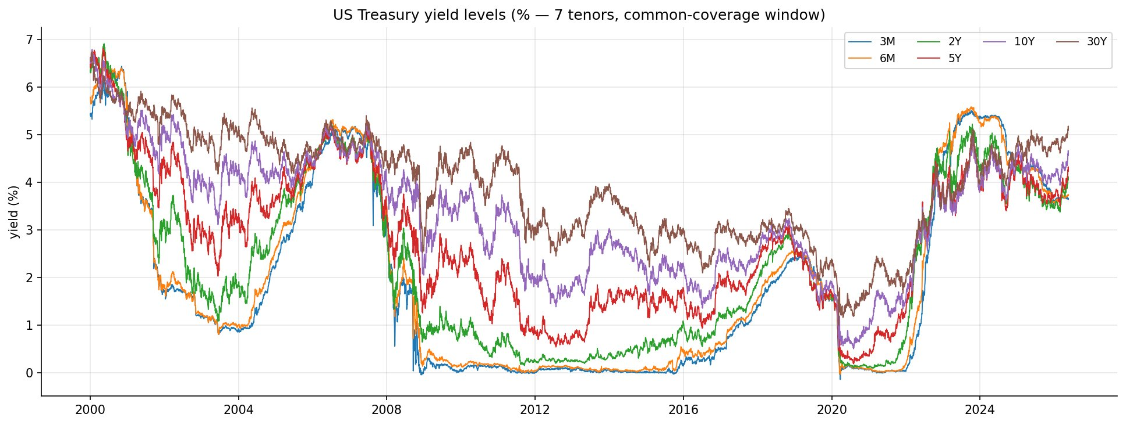
IMPERIAL
B
BUSINESS SCHOOL
Hypothesis: Trade the residual after neutralizing level, slope, and curvature
Most of the yield curve movements can be explained using three factors. We assume the rest is noise that will mean revert.
bp Δ | 3M | 6M | 2Y | 5Y | 10Y | 30Y
mean | -0.01 | -0.01 | -0.02 | -0.02 | -0.02 | -0.02
std | 8.95 | 8.07 | 8.23 | 7.84 | 7.24 | 6.52
min | -127.0 | -110.0 | -118.0 | -108.0 | -67.0 | -56.0
25% | -1.53 | -1.53 | -2.83 | -3.6 | -3.67 | -3.3
50% | 0.0 | 0.0 | 0.0 | 0.0 | 0.0 | 0.0
75% | 1.72 | 1.8 | 2.99 | 3.52 | 3.6 | 3.2
max | 134.0 | 117.0 | 146.0 | 72.0 | 65.0 | 50.0
Data scope is from 1977-02-16 to 2026-05-21. Yield movements are highly collinear, implying that there is a set of systematic factors driving the movement.
Window 1977-02-16 → 2026-05-21 (12,654 obs)
Universe 3M, 6M, 2Y, 5Y, 10Y, 30Y
Split Train: 1977-02-16 ~ 2006-12-22 (7592 days)
Val: 2006-12-25 ~ 2016-09-02 (2530 days)
Test: 2016-09-05 ~ 2026-05-21 (2532 days)
Literature says ≈ 99% of daily variance = level + slope + curvature. Then, the residual movements can represent artifacts of price-insensitive trades which can be exploited.
To capture the residual movements only, it is important we hedge the factor exposures. That is, we must run a relative value book that maintains factor neutrality.
AQMS 2026 · Group 13 · Running a US Treasury Relative-Value Based on PCA
2 / 13
Notes:
Point at the std row: daily changes ~6.5–9 bp, mean ≈ 0, fat tails — mean-reverting moves around a near-zero drift. Stress the held-out discipline: the 2,532-day test block is sealed until slide 12. Hand-off: what are the three factors, and what's left over?

Slide 3
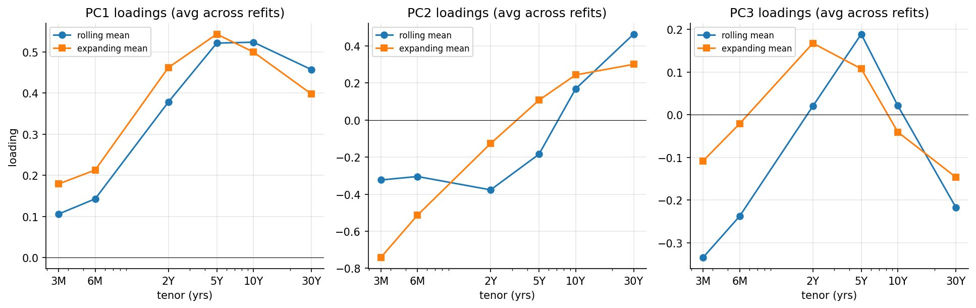
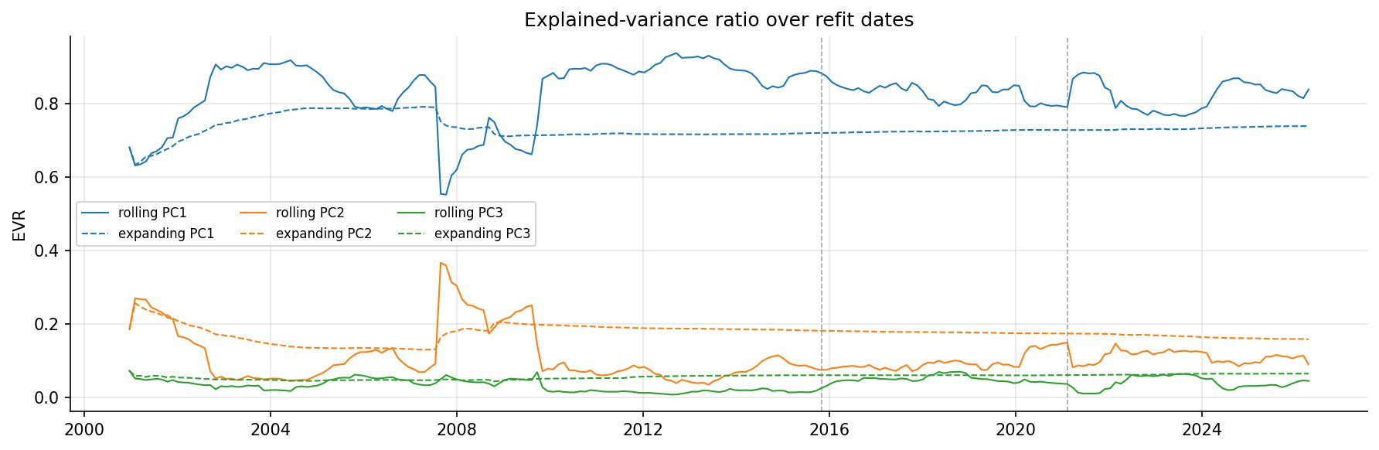
IMPERIAL
B
BUSINESS SCHOOL
Theory: Empirical Findings Confirm Literature Results
The sign pattern we see across the three PCs provide a satisfying, intuitive interpretation.
Used window of 252 days to extract PCA components via rolling method vs expanding method and then computed the mean.
Positive loadings for PC1 indicate level effects, negative short end and positive long end for PC2 indicate slope effect, different signs for belly and wings for PC3 indicate curvature effect.
During GFC, bulk of yield movement can be explained via slope effect (yield curve inversion)
AQMS 2026 · Group 13 · Running a US Treasury Relative-Value Based on PCA
3 / 13
Notes:
PCA = orthogonal directions of max variance. Walk the loading shapes: flat = level, monotone = slope, hump = curvature. EVR > 90% justifies a rank-3 factor model. The residual is the part the 3 factors don't explain; cumulating it gives the tradable signal. Hand-off: how the residual becomes a trade.

Slide 4
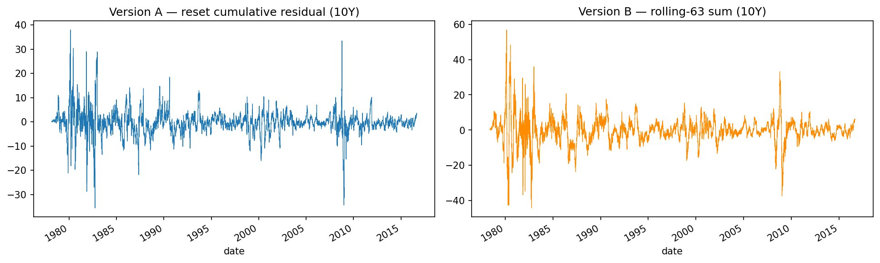
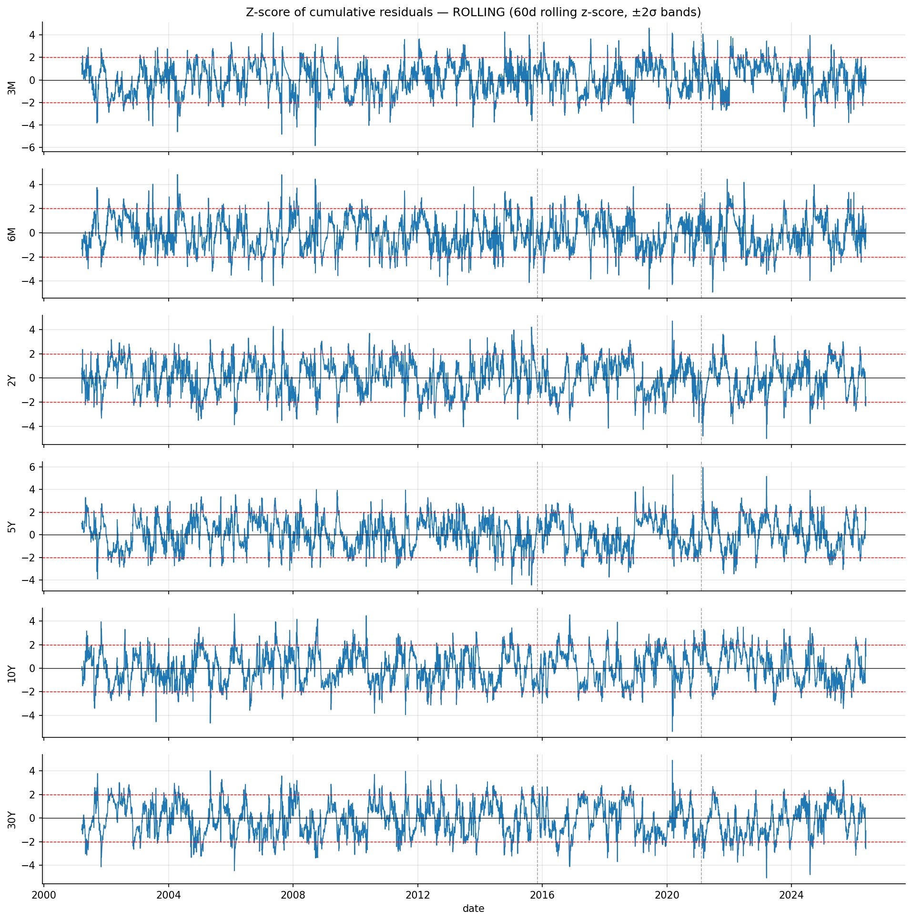
IMPERIAL
B
BUSINESS SCHOOL
Methodology: From residuals to concrete positions
Standardize the cumulative residual into a z-score to build mean-reverting signal. Convert signal to actual trade positions.
Residual rₜ
→
Cumulative Residual cₜ
→
Map to Signal sₜ
→
Trade Vector qₜ
Version A (reset each refit) vs Version B (rolling-K sum), 10Y residual.
Since we are interested in relative valuation of yield levels, we accumulate the residual yield changes and study mean reverting property of cumulative residuals.
Map cumulative residuals to signals (z-score is used in this study) that are tradable
+1-day execution lag throughout to prevent look-ahead bias.
Rolling z-score and ±2σ bands. Potential entry and exit logic.
AQMS 2026 · Group 13 · Running a US Treasury Relative-Value Based on PCA
4 / 13
Notes:
Contrast A (resets each block, cleaner) with B (continuous rolling-K). The z-score is the decision variable: enter when |s| is large, unwind as it reverts. Emphasize causality (trailing windows only) and the +1-day lag. The knob list previews every later refinement. Hand-off: start with the simplest possible book.

Slide 5
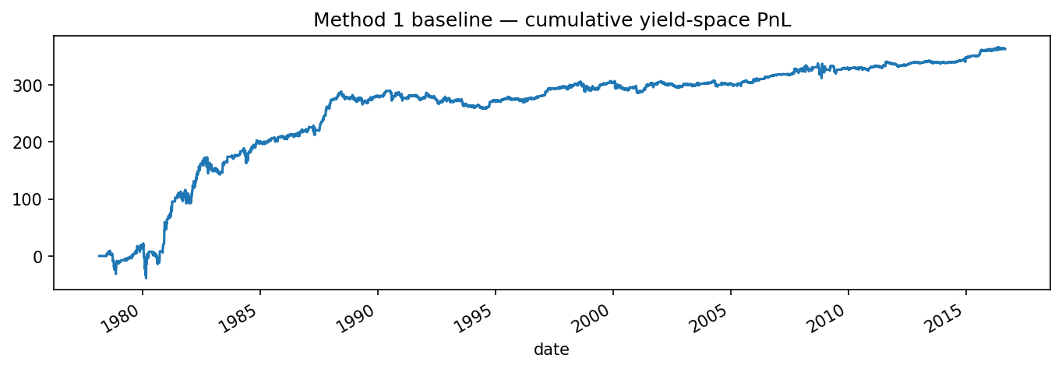
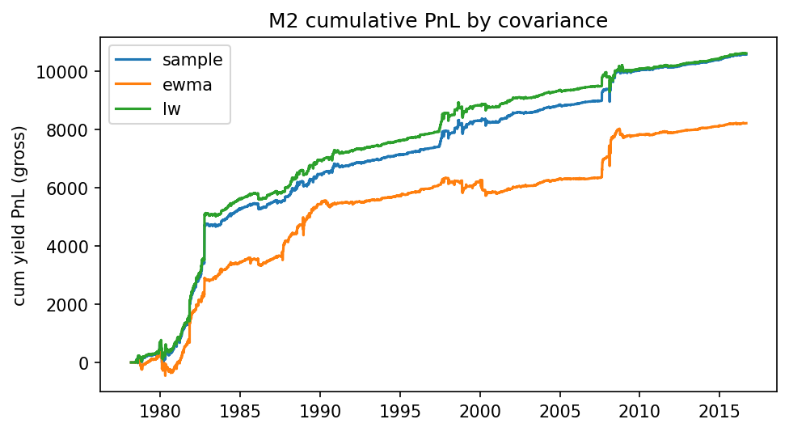
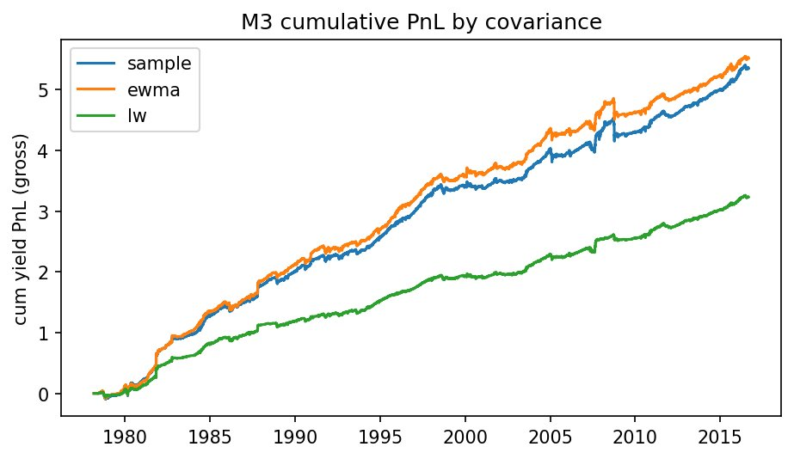
IMPERIAL
B
BUSINESS SCHOOL
Strategies: Three Main Approaches
Start from $ΔΠ_{t+1}≈H_{t}^{T}Δy_{t+1} (H_{t}={Capital}_{t}×kg_{t}).$ We use this approximation to compute a proxy pnl expressed in yield space.
Method 1 — single tenor
Trade only the most-dislocated tenor, projected to neutrality. M is the residual projection. Matrix
g = −sₘ · M eₘ
Method 2 — min-variance hedge
Pin the most-dislocated tenor; hedge the rest to exact neutrality.
min ½ gᵀΣg s.t. Vg = 0, eₘᵀg = −sₘ
method | cov | IR
1 | N/A | 0.505
2 | sample | 0.871
2 | ewma | 0.719
2 | lw | 0.79
3 | sample | 1.249
3 | ewma | 1.263
3 | lw | 1.318
Method 3 — mean-variance
Incorporate size of signal by introducing
α = −s·σ against Σ
(γ can be calibrated to achieve target risk).
max αᵀg − (γ/2) gᵀΣg s.t. Vg = 0
All strategies display positive gross pnl (computed as ${Σ_{t}g}_{t}^{T}{Δy}_{t+1}$) when evaluated in a walk forward manner using intuitive parameters. Method 3, which uses signals from all the tenors, display highest gross pnl. Ledoit-Wolf covariance estimate provides best result.
AQMS 2026 · Group 13 · Running a US Treasury Relative-Value Based on PCA
5 / 13
Notes:
Motivate M1 first (parsimony, one degree of freedom): gross IR ≈ 0.50, proof the residual reverts. M2 = hard-neutral min-variance; M3 = soft mean-variance tilt. Read the IR jump to 1.32 (M3/lw). Call out the M2-all null (IR ≈ 0): over-constraining kills the tilt. γ = 3171.159, neutrality ~1e-13. Hand-off: gross looks great — charge it costs.

Slide 6
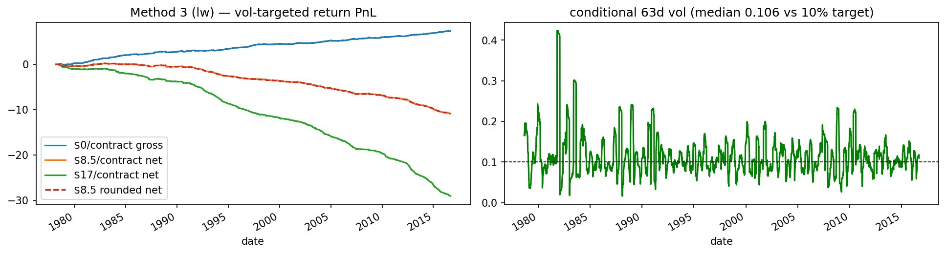
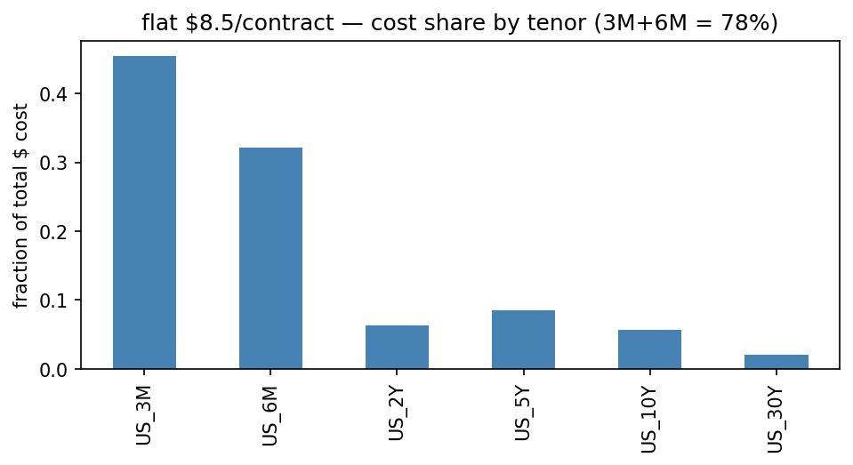
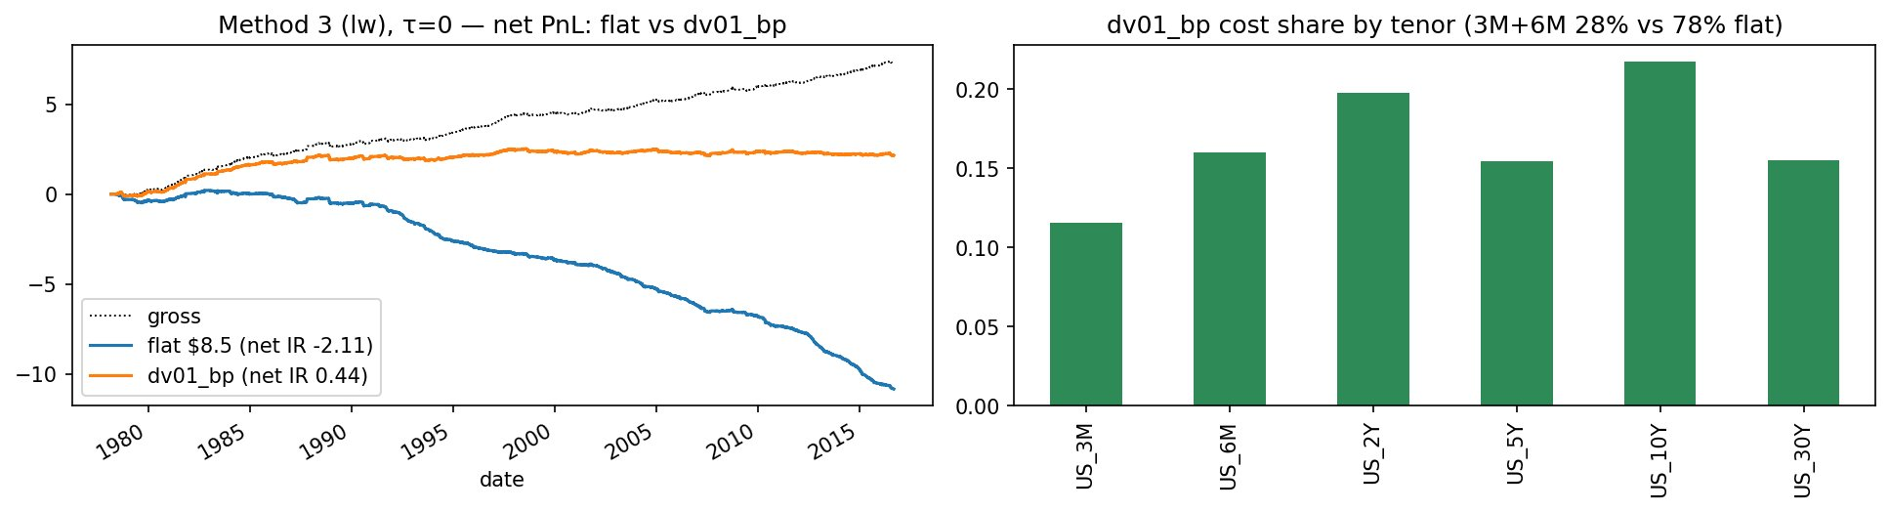
IMPERIAL
B
BUSINESS SCHOOL
Layer 1: Transaction Costs and Vol Targeting (10%)
A flat dollar fee per contract reduces edge completely. DV01 based cost assumption
Performance degradation is real when incorporating cost from crossing the bid-ask spread.
Because turnover for Treasury Bills was high, multiplying by the same flat fee resulted in very high trading costs
Assuming spread in terms of yield, cost = half-spread × DV01 × contracts traded ➔ Results in much equal distribution of costs across tenors
Net IR collapses to -2.11 from 1.5 if assuming flat-fee. If assuming dv01_bps framework, net IR is 0.44 over the training period.
AQMS 2026 · Group 13 · Running a US Treasury Relative-Value Based on PCA
6 / 13
Notes:
Pivotal slide: gross IR 1.3 → flat-net −2.11. Capital-invariance kills the 'trade smaller' reflex. Short-end mechanics: tiny DV01 ⇒ many contracts ⇒ a flat ticket over-charges bills (78% of cost). It's a cost-model artifact. Hand-off: fix the cost model.

Slide 7
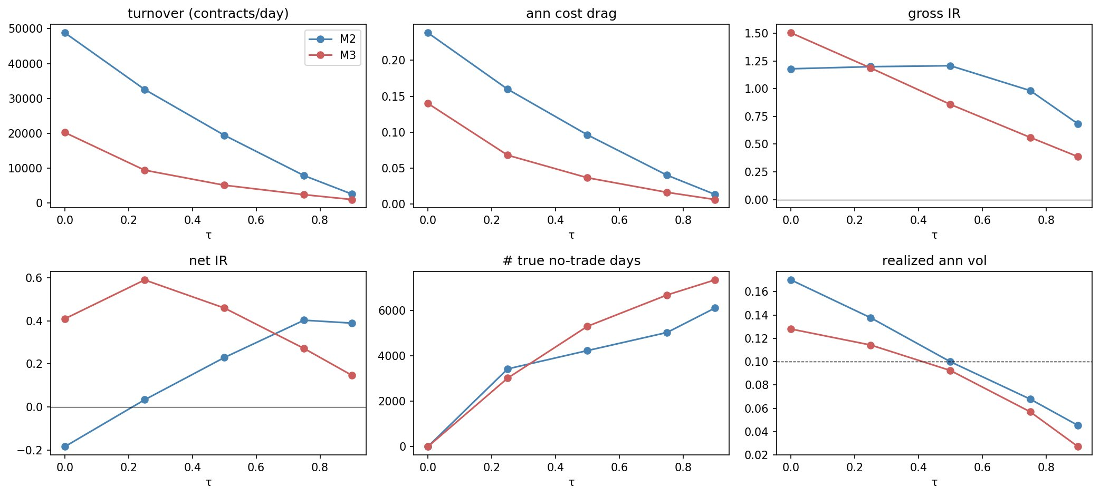
IMPERIAL
B
BUSINESS SCHOOL
Layer 2: Adopting a no-trade band to let weights drift
Define $r_{t}= \frac{{\left\|G_{t} −G_{t−1}\right\|}_{Σ}}{{\left\|G_{t}\right\|}_{Σ}}.$ Only trade when $r_{t}>τ$, but to the edge of the band:$G_{t}^{∗}=G_{t−1}+(1 − τ/r_{t})(G_{t} −G_{t−1})$
Method | τ | Gross IR | Net IR | Cost drag | Vol
2.0 | 0.0 | 1.179 | -0.184 | 0.238 | 0.17
2.0 | 0.25 | 1.198 | 0.033 | 0.16 | 0.138
2.0 | 0.5 | 1.206 | 0.229 | 0.096 | 0.1
2.0 | 0.75 | 0.982 | 0.403 | 0.04 | 0.068
2.0 | 0.9 | 0.682 | 0.389 | 0.014 | 0.045
3.0 | 0.0 | 1.503 | 0.409 | 0.14 | 0.128
3.0 | 0.25 | 1.186 | 0.59 | 0.068 | 0.114
3.0 | 0.5 | 0.857 | 0.459 | 0.037 | 0.092
3.0 | 0.75 | 0.561 | 0.271 | 0.016 | 0.057
3.0 | 0.9 | 0.386 | 0.147 | 0.006 | 0.027
Sweeping the band τ: turnover and cost drag fall while gross IR erodes only slowly. This leads to higher net IR. Threshold of 0.75 seems to be the best choice.
Motivation: Methods 2 and 3 emit continuous weight vectors every time step. Thus, we end up rebalancing every day, resulting in high trading costs. To address this issue, we introduce a no-trade band area in which we let our weights drift. That is, we trade-off between perfect neutrality and lower turnover.
Increasing threshold from 0 to 1 causes turnover to decrease rapidly while theoretical edge decays at a slower rate. This results in higher net IR.
AQMS 2026 · Group 13 · Running a US Treasury Relative-Value Based on PCA
8 / 13
Notes:
An RV book otherwise rebalances daily (every tenor moves to hedge 3 factors). The band: hold, and only trade when risk-space (Mahalanobis) drift exceeds τ, then trade to the edge and freeze integer contracts. Read the sweep: turnover/cost drag fall, gross erodes slowly. GO; M2 τ=0.75 recommended (net 0.403, +50% 0.096, ex-proxy 0.615). M3 stays net-positive but its gross erodes >20% (fails band-health). Hand-off: two orthogonal refinements remain.

Slide 8
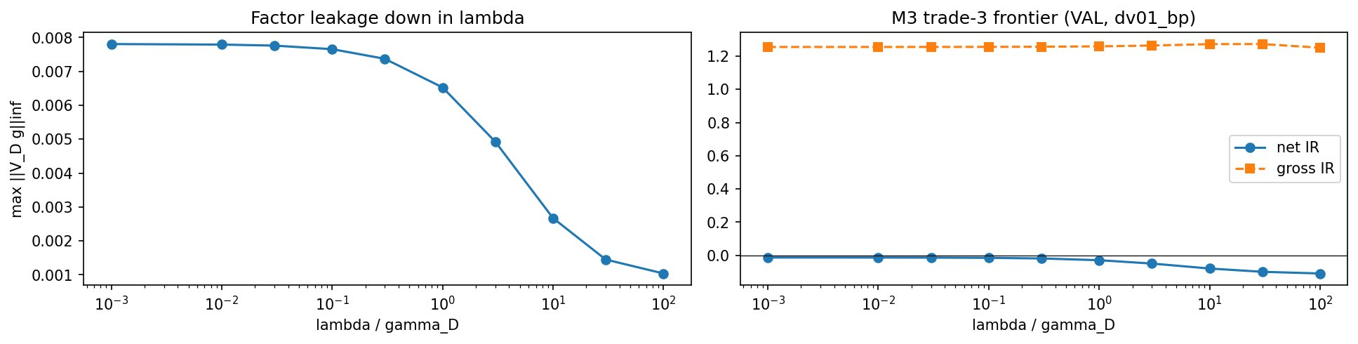
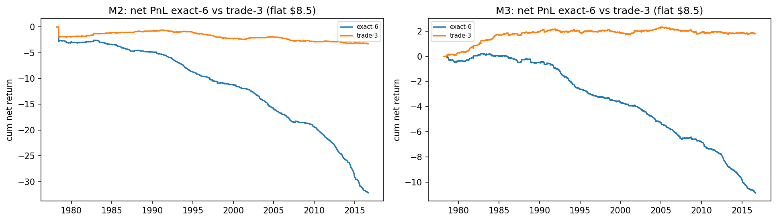
IMPERIAL
B
BUSINESS SCHOOL
Layer 3: Hedge Imperfectly
Relax exact neutrality to a small factor leakage budget λ — Trade only 2Y / 5Y / 10Y.
method | universe | Gross IR | Net IR | leak | turnover
M2 | all-6 | 1.1614 | -0.5077 | 0.0 | 0.0054
M2 | trade-3 | 0.673 | -0.3673 | 0.191 | 0.0044
M2-all | all-6 | 0.0131 | -1.4454 | 0.0 | 0.0093
M2-all | trade-3 | 0.1497 | -0.4609 | 0.5091 | 0.0012
M3 | all-6 | 1.496 | -0.1222 | 0.0 | 0.0035
M3 | trade-3 | 1.2555 | -0.0131 | 0.3175 | 0.0027
As we increase the cost coefficient, we see that factor leakage drops to zero, but this comes with reduced net IR
Trading only the three tenors provides massive performance bumps. For method 3, we see positive IR, although performance seemed to plateau in 1990.
AQMS 2026 · Group 13 · Running a US Treasury Relative-Value Based on PCA
9 / 13
Notes:
With 3 instruments and 3 factors the only exactly-neutral book is zero — so neutrality becomes a soft penalty λ (the dual of a 2-norm leakage ball; an optional cvxpy QP reproduces the closed form to ~1e-11). γ_D(train)=1437.1; λ*/γ_D = {M2:100, M3:0}. M3 net IR exact-6 −0.122 → trade-3 −0.013 (turnover 0.0035→0.0027); leakage ≈ 0.318. Both still net-negative bandless — the band is the load-bearing fix. Hand-off: dodge bad regimes.

Slide 9
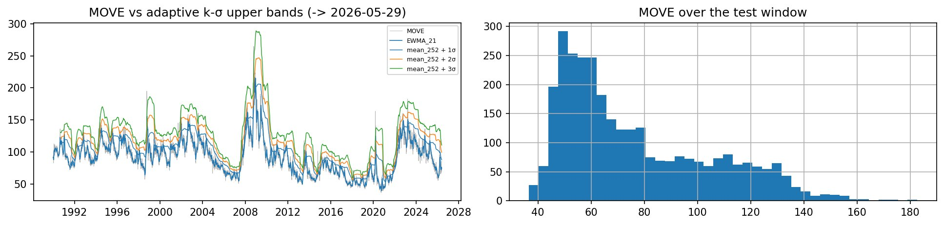
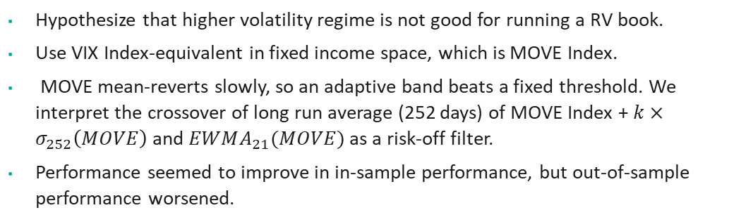
IMPERIAL
B
BUSINESS SCHOOL
Layer 4: Regime Filtering Based on MOVE Index
Flatten when MOVE pierces its upper ban. Performance seemed to improve in-sample, but that wasn’t the case in out-of-sample.
k (VAL) | net IR | MDD | # days filtered
none | 0.0078 | 0.1997 | 0
1 | 0.1205 | 0.1439 | 1181
2 | 0.0361 | 0.1806 | 267
3 | 0.0078 | 0.1997 | 0
Hypothesize that higher volatility regime is not good for running a RV book.
Use VIX Index-equivalent in fixed income space, which is MOVE Index.
MOVE mean-reverts slowly, so an adaptive band beats a fixed threshold. We interpret the crossover of long run average (252 days) of MOVE Index + $k×σ_{252}\left(MOVE\right)$ and $EWMA_{21}(MOVE)$ as a risk-off filter.
Performance seemed to improve in in-sample performance, but out-of-sample performance worsened.
AQMS 2026 · Group 13 · Running a US Treasury Relative-Value Based on PCA
10 / 13
Notes:
Motivate regime conditioning: dispersion is the friend, systematic risk the foe. Adaptive band (252d mean + k·σ vs EWMA-21) beats a static threshold for the slow-mean-reverting MOVE. VAL k=1 best (MDD 0.20→0.14). Then the honest OOS reversal on the single test touch (−0.110 → −0.501). Hand-off: stress the signal itself.

Slide 10
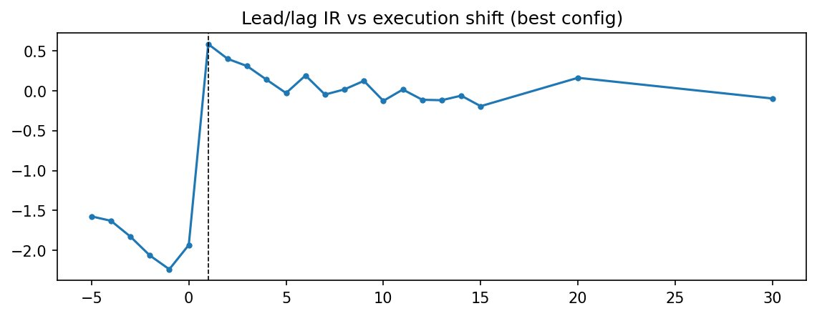
IMPERIAL
B
BUSINESS SCHOOL
Robustness Check
Lead-lag, jackknife and bootstrap analysis indicates the edge holds, with honest caveats.
Dropped | IR_reduced | ΔIR
US_3M | -0.101 | 0.651
US_6M | -0.211 | 0.761
US_2Y | 0.429 | 0.121
US_5Y | -0.182 | 0.732
US_10Y | -0.126 | 0.676
US_30Y | 0.293 | 0.258
IR peaks at the causal +1-day shift (0.585).
Lead-lag: IR peaks at +1 (0.585). We see slow decay for positive lags. However, IR drops by a huge margin when we have negative lags. This is expected behavior for a mean reversion strategy.
Jackknife. Tested on best performing in-sample strategy (M3). As we have confirmed, dropping the short end yield instruments in our universe improves net IR. In general, dropping instruments from our universe lead to increase in IR.
Bootstrap. Validation mean PnL sits inside the upper and lower bands of bootstrap mean-pnl.
AQMS 2026 · Group 13 · Running a US Treasury Relative-Value Based on PCA
11 / 13
Notes:
Lead-lag peak at +1 is causal; be candid it doesn't fully decay by 30 days (tracked caveat). Jackknife: M2/lw IR_all 0.550, dropping 6M costs ΔIR 0.76 (single-tenor-dependent); the imperfect trade-3 winner is NOT. Bootstrap: val mean inside the train band; z-window stabilizes by 126. Hand-off: tune honestly and touch the test once.

Slide 11
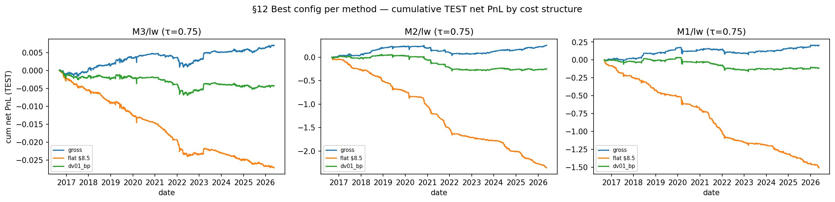
IMPERIAL
B
Best M1/M2/M3 on the held-out TEST split under gross / flat $8.5 / dv01_bp costs.
BUSINESS SCHOOL
Tune on Validation, Check on Test Set
Tune parameters over validation. Final Test on hold-out. Despite our multiple trials, alpha couldn’t survive after trading costs.
Method | Cov | Cost | IR_test | MDD
3 | lw | gross | 0.5127 | 0.0038
3 | lw | flat $8.5 | -1.8898 | 0.0272
3 | lw | dv01_bp | -0.3132 | 0.0071
2 | lw | gross | 0.4679 | 0.2181
2 | lw | flat $8.5 | -3.3838 | 2.3554
2 | lw | dv01_bp | -0.4494 | 0.3532
1 | lw | gross | 0.4702 | 0.0996
1 | lw | flat $8.5 | -2.5473 | 1.5142
1 | lw | dv01_bp | -0.2545 | 0.1992
Use Optuna to search grid space intelligently. Search only on train+val to prevent leakage. Best validation net IR was 0.830.
Gross test IR positive for all three (M3 0.51, M2 0.47, M1 0.47).
Despite various layers, we were not able to beat costs in our test set.
AQMS 2026 · Group 13 · Running a US Treasury Relative-Value Based on PCA
12 / 13
Notes:
Optuna vs a coarse grid; leakage guards (train+val only, cached). One config per method, a single test touch. Gross generalizes (test IR 0.47–0.51, bolded), but net is thin/negative under dv01_bp (M3 −0.31, M2 −0.45, M1 −0.25). Hand-off: the lessons.

Slide 12
IMPERIAL
B
BUSINESS SCHOOL
Conclusion: Limitations and Improvements
What we learned
Limitations & next steps
Gross alpha is real and generalizes out-of-sample.
Costs were the largest barriers to our strategy.
Trading less often beats trading-smarter.
More constraints ≠ better; in-sample ≠ out-of-sample — reported, not hidden.
Cash/par yields, not futures — carry & roll-down omitted (the band lengthens holds).
Cash/par DV01, not CTD-forward; cost model ignores market impact at size.
Next: add carry + CTD DV01, a turnover penalty, and combine band + cheap hedge + regime filter.
The edge seemed to exist. The important question is: How can we trade in a manner that minimizes trading costs?
AQMS 2026 · Group 13 · Running a US Treasury Relative-Value Based on PCA
13 / 13
Notes:
Synthesize the ladder: real gross alpha → costs are the battleground → model them honestly → trade less → more constraints aren't better → in-sample ≠ out-of-sample. Be explicit about the futures/carry/CTD gaps. End on the execution-cost framing.

